Slide 1
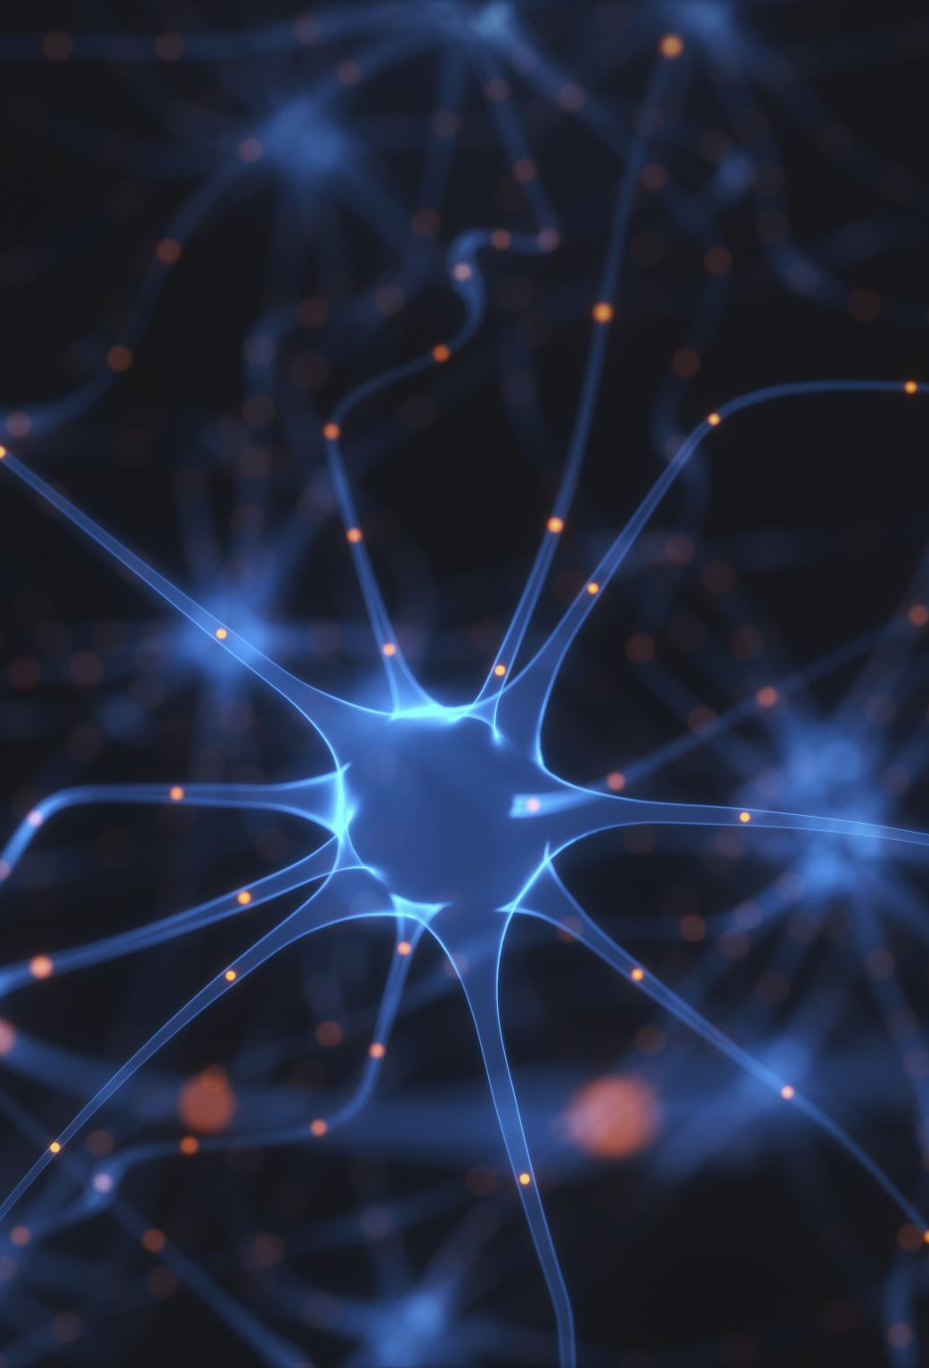
ImageNet Classification with Deep Convolutional Neural Networks
Authors:
Alex Krizhevsky
Ilya Sutskever
Geoffrey E. Hinton
Name: Veerendra Reddy Ariga
Student ID: 700762092
University of central Missouri

Slide 2

Motivation
1. Significance in Computer Vision
2. Innovation in Model Design
3. Performance Improvements
4. Scalability and Efficiency
5. Broader Implications
6. Limitations and Future Work

Slide 3
Motivation
Significance in Computer Vision: Emphasize how this research addresses a critical challenge in computer vision and its impact on the field.
Innovation in Model Design: Highlight the novel aspects of the model, such as the use of ReLU nonlinearity, dropout, and GPU-based training.
Performance Improvements: Showcase the significant reduction in error rates achieved by this model compared to previous state-of-the-art results.
Scalability and Efficiency: Discuss how the model efficiently handles large-scale data and the importance of GPU acceleration in training.
Broader Implications: Mention how the success of this research sets the stage for future developments in deep learning and computer vision.
Limitations and Future Work: Acknowledge the limitations, such as the need for powerful hardware and large labeled datasets, and suggest areas for future exploration.

Slide 4
Problem Statement
1. High Error Rates
2. Overfitting Large
3. Scalability
4. Training Efficiency
5. Data Dependence

Slide 5
Problem Statement
The rapid growth of digital media has resulted in an enormous volume of images that need to be accurately classified and organized. Traditional image classification methods often struggle with high error rates, overfitting, and scalability issues. To address these challenges, this study investigates the application of deep convolutional neural networks (CNNs) to large-scale image classification tasks using the ImageNet dataset. The specific problems addressed include:
High Error Rates: Existing models exhibit high error rates in image classification, which hampers their practical usability.
Overfitting: Large neural networks often suffer from overfitting, limiting their generalization capabilities.
Scalability: Managing and processing millions of images efficiently requires scalable and robust models.
Training Efficiency: Training deep networks is computationally intensive and time-consuming, necessitating the use of advanced hardware and optimization techniques.
Data Dependence: Effective image classification often relies on large, labeled datasets, which may not be available in all domains.
By developing a CNN with 60 million parameters, five convolutional layers, and three fully connected layers, this study aims to achieve significant improvements in accuracy and efficiency, leveraging innovations such as ReLU nonlinearity, dropout regularization, GPU acceleration, and data augmentation. The ultimate goal is to set a new benchmark in image classification and pave the way for future advancements in deep learning and computer vision.

Slide 6
Objectives
Improve
Improve Classification Accuracy
Address
Address Overfitting
Leverage
Leverage Hardware Advancements
Optimize
Optimize Training Efficiency
Enhance
Enhance Model Scalability
Utilize
Utilize Data Augmentation
Set
Set a New Benchmark

Slide 7
Objectives
Improve Classification Accuracy : - Develop a deep convolutional neural network (CNN) to significantly reduce error rates in image classification tasks compared to previous state-of-the-art models.
Address Overfitting : - Implement advanced regularization techniques, such as dropout, to minimize overfitting and enhance the model's generalization capabilities.
Leverage Hardware Advancements : - Utilize GPU acceleration to speed up the training process, making it feasible to train large and complex networks efficiently.
Optimize Training Efficiency : - Incorporate non-saturating activation functions (ReLU) to accelerate the training process and improve the performance of the network.
Enhance Model Scalability : - Design a scalable network architecture capable of handling large datasets, specifically focusing on the 1.2 million images from the ImageNet dataset.
Utilize Data Augmentation : - Apply data augmentation and normalization techniques to improve the model's ability to generalize from the training data to unseen images.
Set a New Benchmark : - Achieve and demonstrate superior performance on the ImageNet LSVRC-2010 and ILSVRC-2012 datasets, setting a new standard for image classification models.

Slide 8

Contributions
1. Innovative Network Design
2. Reduction of Error Rates
3. Dropout Regularization
4. Benchmark Performance
5. Future Research Implications

Slide 9
Contributions
Innovative Network Design : Developed a deep convolutional neural network (CNN) with 60 million parameters, five convolutional layers, and three fully connected layers, demonstrating a significant advancement in network architecture for image classification.
Reduction of Error Rates : Achieved error rates of 37.5% and 17.0% on the ImageNet LSVRC-2010 dataset and 15.3% on the ILSVRC-2012 contest, substantially lower than previous state-of-the-art models.
Use of ReLU Nonlinearity : Implemented ReLU (Rectified Linear Units) activation functions, which greatly sped up the training process and improved model performance compared to traditional activation functions like tanh.
Dropout Regularization : Introduced dropout as a regularization technique to mitigate overfitting, enhancing the generalization capability of the neural network.
GPU Acceleration : Leveraged GPU-based convolution operations to significantly accelerate the training process, enabling the handling of large and complex models efficiently.

Slide 10
Contributions
Benchmark Performance : Set new performance benchmarks on the ImageNet dataset, demonstrating the efficacy of the proposed methodologies and inspiring subsequent research in deep learning and computer vision.
Scalability and Efficiency : Showcased the scalability of the CNN architecture, capable of efficiently processing and classifying large-scale datasets like ImageNet, paving the way for its application in other large-scale image recognition tasks.
Future Research Implications : Provided a foundation for future advancements by demonstrating the potential of deep CNNs, motivating further exploration of more powerful GPUs, larger datasets, and enhanced training techniques in the field.

Slide 11
Results
1. Error Rates on ImageNet LSVRC-2010
2. Error Rate on ILSVRC-2012
3. Impact of ReLU Activation
4. Effectiveness of Dropout
5. GPU Training Efficiency
6. Scalability and Practicality
7. Benchmark Achievement

Slide 12
Results
Error Rates on ImageNet LSVRC-2010 : Achieved top-1 and top-5 error rates of 37.5% and 17.0%, respectively, significantly outperforming previous state-of-the-art models.
Error Rate on ILSVRC-2012 : Attained a top-5 error rate of 15.3% in the ILSVRC-2012 contest, demonstrating a marked improvement over existing methodologies.
Impact of ReLU Activation : The use of ReLU activation functions led to faster training times and improved performance compared to traditional activation functions like tanh and sigmoid.
Effectiveness of Dropout : Implementing dropout regularization reduced overfitting, resulting in better generalization to new, unseen data.
GPU Training Efficiency : Leveraged GPU acceleration to train the network in five to six days, highlighting the importance of hardware advancements in deep learning research.
Scalability and Practicality : Demonstrated that the proposed CNN architecture can handle large-scale datasets effectively, paving the way for its application in various real-world image classification tasks.

Slide 13

Critical Analysis
Strengths
- Innovative Design: The CNN architecture with 60 million parameters sets a new standard in model complexity and effectiveness.
- ReLU Activation: Speeds up training significantly compared to traditional functions.
- Dropout Regularization: Effectively reduces overfitting, improving generalization.
- GPU Utilization: Enables efficient training of large networks.
- Data Augmentation: Enhances model robustness and performance.
Weaknesses
- High Computational Requirements: Requires powerful GPUs, limiting accessibility.
- Training Time: Takes five to six days, which may be impractical for some uses.
- Dependency on Large Datasets: Not suitable for domains without large labeled datasets.

Slide 14

Critical Analysis
Opportunities
- Future Hardware Improvements: Faster training with advancing GPU technology.
- Transfer Learning: Pretrained models can be adapted for other tasks.
- Broader Applications: Techniques can inspire advancements in other AI fields.
Threats
- Hardware Limitations: High demands may limit adoption in resource-constrained environments.
- Data Privacy and Availability: Challenges in accessing large, labeled datasets.
Future Research Implications
- Scalability and Efficiency: Focus on reducing computational demands.
- Broader Dataset Utilization: Develop methods for smaller or less labeled datasets.
- Integration of New Techniques: Continue innovating in neural network design and hardware acceleration.

Slide 15

References
https://proceedings.neurips.cc/paper_files/paper/2012/file/c399862d3b9d6b76c8436e924a68c45b-Paper.pdf

